Slide 1
Robot Operating System – ROS
Practicalities

Slide 2

1
ROS Namespaces
2
ROS Namespaces Example
3
ROS Parameter Files
4
ROS Parameter Files Examples
Table of contents
5
ROS Custom Messages
6
ROS Custom Messages Examples
7
ROS Activity
8
Questions

Slide 3
Robot Operating System – ROS
Namespaces

Slide 4
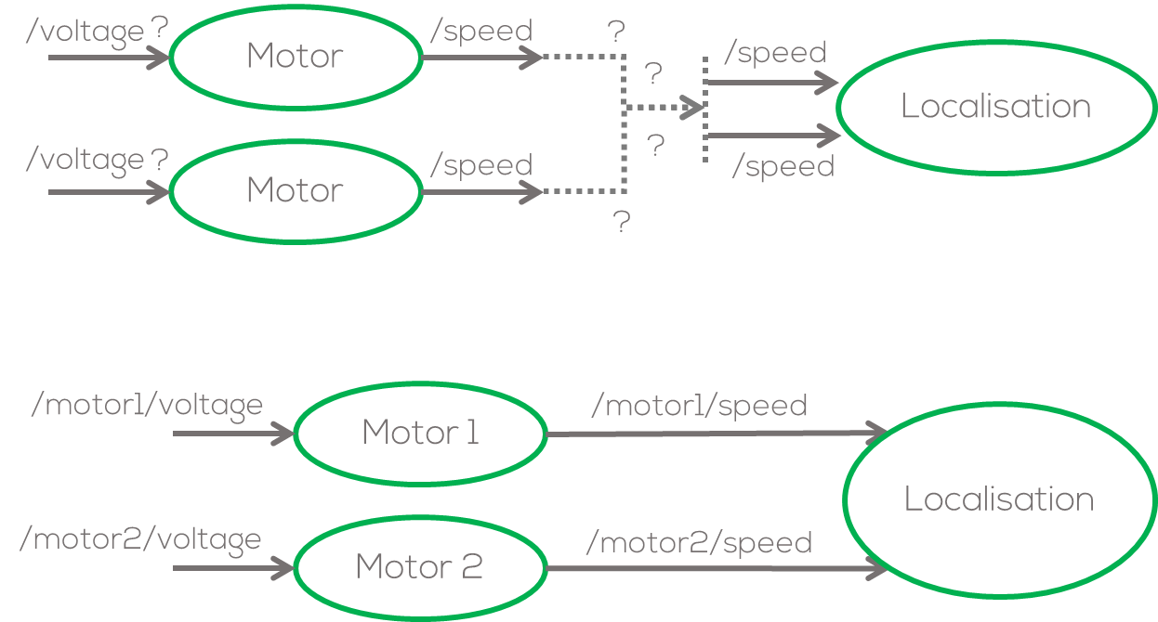
ROS Namespaces
Imagine the following problem: you have a node that simulates a motor, and you require to simulate two (or more) motors using the same code.
The problem in ROS will be the naming convention for the nodes and the topics to which the motor node subscribes, and where it publishes; since they will both be the same.
One simple solution will be to change the name of the nodes and topics manually by generating multiple .py files. For complex system this is not a good option. (What would happen if I require 10 motors?)
Namespaces then become the best option to deal with name collisions, when systems become more complex.

Slide 5
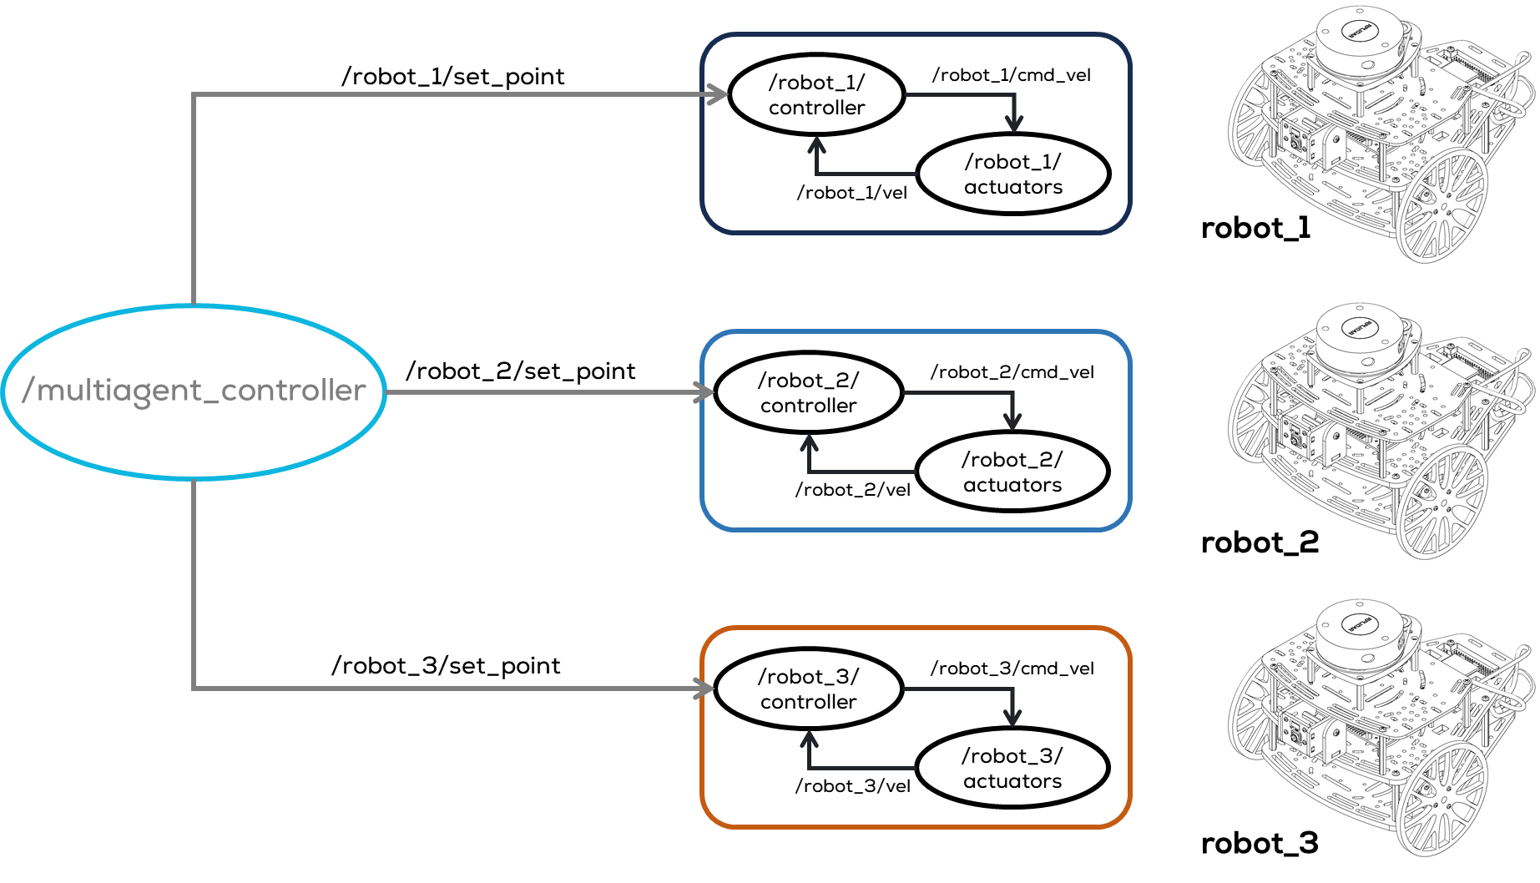
ROS Namespaces
A namespace in ROS can be viewed as a directory that contains items with different names.
The items can be nodes, topics or other namespaces (hierarchy).
There are several ways to define the namespaces. The easiest way is via the command line, which is very easy but not recommended for larger projects.
In this presentation, the launch file will be used to define the namespaces.

Slide 6
Activity 1
ROS Namespaces

Slide 7
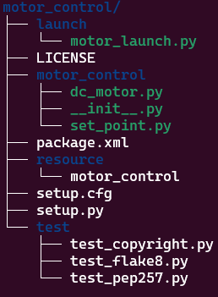
Activity 1 – ROS Namespaces
Requirements
You can download the motor_control template package from Github (Week 2/Activities/Activity 2/Templates).
Activity starts in slide 14
Objective
The objective of this activity is to learn about namespaces.
Instructions
Download the motor_control package from GitHub (inside Templates).
Add it to your source directory inside your workspace

Slide 8
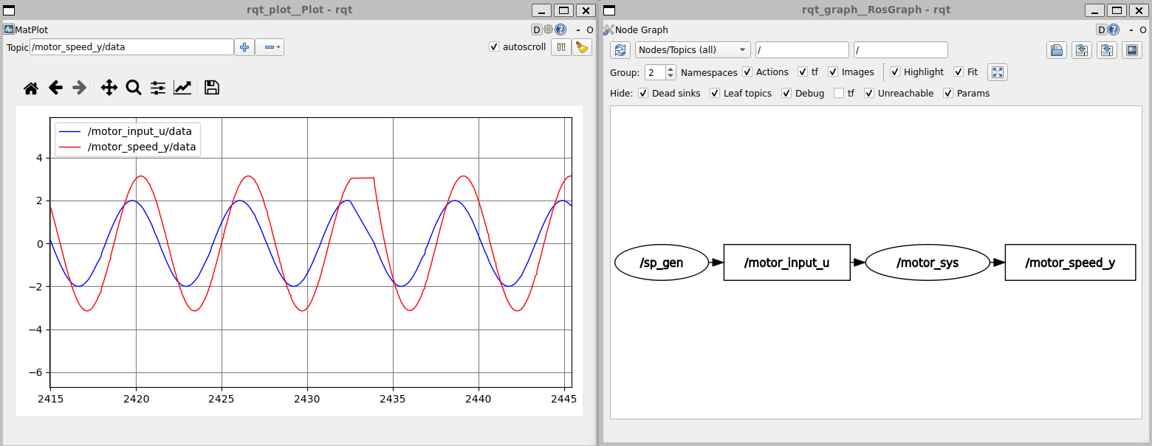
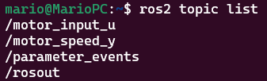
Activity 1 – ROS Namespaces
Instructions
Compile the package using colcon
Launch the package
Open two terminals run the rqt_graph and the rqt_plot
Results
If everything goes well, you should see the following
Check the published topics
$ cd ~/ros2_ws
$ colcon build
$ source install/setup.bash
$ ros2 launch motor_control motor_launch.py
$ ros2 run rqt_plot rqt_plot
$ ros2 run rqt_graph rqt_graph

Slide 9
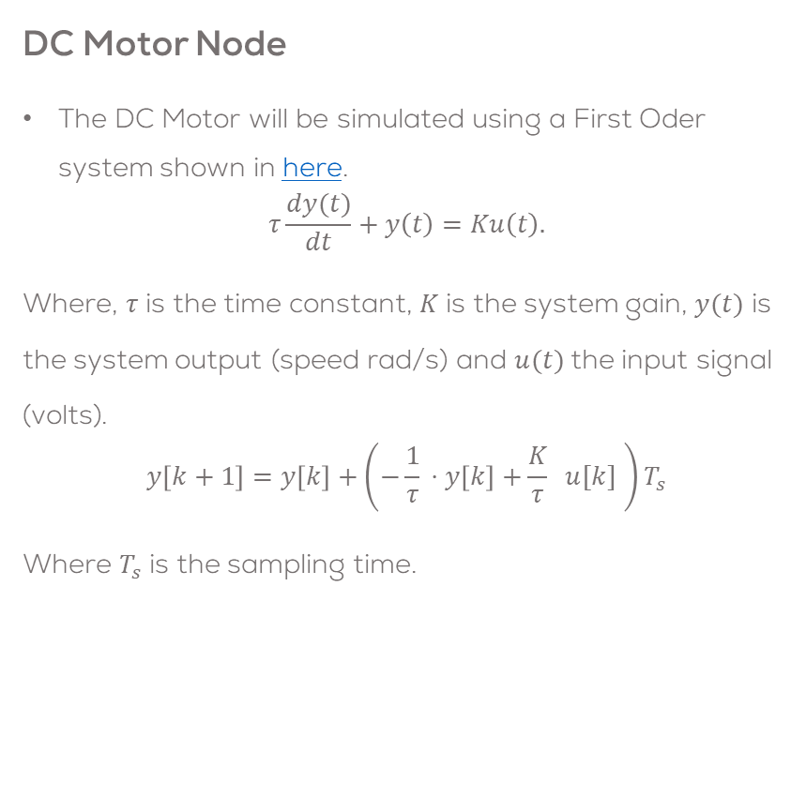
Activity 1 – ROS Namespaces
Motor Control package
The package is composed of two nodes:
dc_motor node: Simulate a First Order System, representing a DC Motor.
set_point node: Providing an input for the system
You can see the contents of each node by opening the file on any text editor (gedit, vscode, nano, vim, etc.)
DC Motor Node
The DC Motor will be simulated using a First Oder system shown in here.
$$τ\frac{dy(t)}{dt}+y\left(t\right)=Ku\left(t\right).$$
Where, $τ$ is the time constant, $K$ is the system gain, $y(t)$ is the system output (speed rad/s) and $u(t)$the input signal (volts).
$$y\left[k+1\right]=y\left[k\right]+\left(−\frac{1}{τ}​⋅y\left[k\right]+\frac{K}{τ}​ ​ u[k] \right)T_{s}$$
Where $T_{s}$is the sampling time.
motor_control/motor_control/dc_motor.py
motor_control/motor_control/set_point.py

Slide 10
Activity 1 – ROS Namespaces
Start Node
DC Motor Node Structure
The node subscribes to the topic “/motor_input_u” and publishes the vales of the motor speed on the topic “/motor_output_y”.
Both topics contain an interface (message) Float32
Initialise parameters
Sample time
Motor parameters
Initial conditions
Create variables
ROS Comms Interfaces and timers:
Subscriber(motor_input_u)
Publisher(motor_output_y)
Timer (timer_cb)
Shutdown
Exit signal
/motor_input_u
/motor_node
/motor_output_y
Waiting for events (callbacks)
ROS2 Spin
New input received
Timer
timeout
Subscriber Callback (input_callback)
Update motor input (input_u)
Timer Callback (timer_cb)
Compute motor speed
Publish result
Update motor output

Slide 11
dc_motor.py
# Imports
import rclpy
from rclpy.node import Node
from std_msgs.msg import Float32
#Class Definition
class DCMotor(Node):
def __init__(self):
super().__init__('dc_motor')
# DC Motor Parameters
self.sample_time = 0.02
self.param_K = 1.75
self.param_T = 0.5
self.initial_conditions = 0.0
#Set the messages
self.motor_output_msg = Float32()
#Set variables to be used
self.input_u = 0.0
self.output_y = self.initial_conditions
#Declare publishers, subscribers and timers
self.motor_input_sub = self.create_subscription(Float32, 'motor_input_u', self.input_callback,10)
self.motor_speed_pub = self.create_publisher(Float32, 'motor_speed_y', 10)
self.timer = self.create_timer(self.sample_time, self.timer_cb)
#Node Started
self.get_logger().info('Dynamical System Node Started \U0001F680')
Timer callback:
Motor simulation
#Timer Callback
def timer_cb(self):
#DC Motor Simulation
#DC Motor Equation 𝑦[𝑘+1] = 𝑦[𝑘] + ((−1/𝜏) 𝑦[𝑘] + (𝐾/𝜏) 𝑢[𝑘]) 𝑇_𝑠
self.output_y += (-1.0/self.param_T * self.output_y + self.param_K/self.param_T * self.input_u) * self.sample_time
#Publish the result
self.motor_output_msg.data = self.output_y
self.motor_speed_pub.publish(self.motor_output_msg)
#Subscriber Callback
def input_callback(self, input_sgn):
self.input_u = input_sgn.data
#Main
def main(args=None):
rclpy.init(args=args)
node = DCMotor()
try:
rclpy.spin(node)
except KeyboardInterrupt:
pass
finally:
node.destroy_node()
rclpy.try_shutdown()
#Execute Node
if __name__ == '__main__':
main()
Libraries
Initialise parameters
Subscriber callback
Main
ROS publishers, subscribers Timers

Slide 12
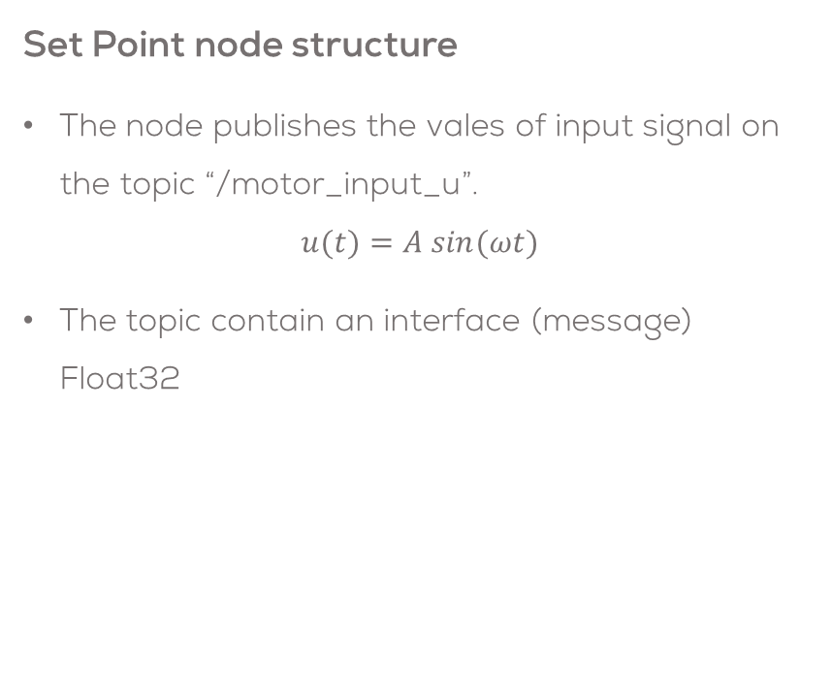
Activity 1 – ROS Namespaces
Start Node
Set Point node structure
The node publishes the vales of input signal on the topic “/motor_input_u”.
$$u(t)=A sin(ωt)$$
The topic contain an interface (message) Float32
Initialise parameters
Signal paameters
Create variables
ROS Comms Interfaces and timers:
Publisher(motor_input_u)
Timer (timer_cb)
Shutdown
Exit signal
Waiting for events (callbacks)
/set_point_node
Timer
timeout
ROS2 Spin
/motor_input_u
Timer Callback (timer_cb)
Compute elapsed time
Generate signal
Publish signal

Slide 13
set_point.py
# Imports
import rclpy
from rclpy.node import Node
import numpy as np
from std_msgs.msg import Float32
#Class Definition
class SetPointPublisher(Node):
def __init__(self):
super().__init__('set_point_node')
# Retrieve sine wave parameters
self.amplitude = 2.0
self.omega = 1.0
#Create a publisher and timer for the signal
self.signal_publisher = self.create_publisher(Float32, 'motor_input_u', 10)
timer_period = 0.1 #seconds
self.timer = self.create_timer(timer_period, self.timer_cb)
#Create a messages and variables to be used
self.signal_msg = Float32()
self.start_time = self.get_clock().now()
self.get_logger().info("SetPoint Node Started \U0001F680")
# Timer Callback: Generate and Publish Sine Wave Signal
def timer_cb(self):
#Calculate elapsed time
elapsed_time = (self.get_clock().now() - self.start_time).nanoseconds/1e9
# Generate sine wave signal
self.signal_msg.data = self.amplitude * np.sin(self.omega * elapsed_time)
# Publish the signal
self.signal_publisher.publish(self.signal_msg)
#Main
def main(args=None):
rclpy.init(args=args)
set_point = SetPointPublisher()
try:
rclpy.spin(set_point)
except KeyboardInterrupt:
pass
finally:
set_point.destroy_node()
rclpy.try_shutdown()
#Execute Node
if __name__ == '__main__':
main()
Libraries
Timer callback:
Signal Generator
Initialise parameters
Main
ROS publishers, subscribers Timers

Slide 14
motor_launch.py
from launch import LaunchDescription
from launch_ros.actions import Node
def generate_launch_description():
motor_node = Node(name="motor_sys",
package='motor_control',
executable='dc_motor',
emulate_tty=True,
output='screen',
)
sp_node = Node(name="sp_gen",
package='motor_control',
executable='set_point',
emulate_tty=True,
output='screen',
)
l_d = LaunchDescription([motor_node, sp_node])
return l_d
The launch file starts a motor_node and a set_point node.

Slide 15
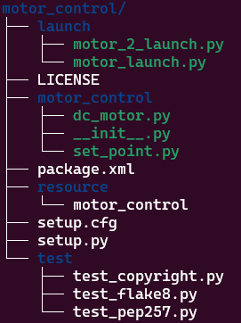
Activity 1 – ROS Namespaces
Adding a namespace
Create an motor2_launch.py file in the launch folder of the motor_control package.
Open the motor_2_launch.py using a text editor.
Copy the following code (next slide)
Folder Tree
$ cd ~/ros2_ws/src/motor_control/launch
$ touch motor_2_launch.py
$ chmod +x motor_2_launch.py

Slide 16
Activity 1 – ROS Namespaces
from launch import LaunchDescription
from launch_ros.actions import Node
def generate_launch_description():
motor_node_1 = Node(name="motor_sys_1",
package='motor_control',
executable='dc_motor',
emulate_tty=True,
output='screen',
namespace="group1"
)
sp_node_1 = Node(name="sp_gen_1",
package='motor_control',
executable='set_point',
emulate_tty=True,
output='screen',
namespace="group1"
)
motor_node_2 = Node(name="motor_sys_2",
package='motor_control',
executable='dc_motor',
emulate_tty=True,
output='screen',
namespace="group2"
)
sp_node_2 = Node(name="sp_gen_2",
package='motor_control',
executable='set_point',
emulate_tty=True,
output='screen',
namespace="group2"
)
l_d = LaunchDescription([motor_node_1, sp_node_1, motor_node_2, sp_node_2])
return l_d
Imports
Launch body
Launch body
Set launch content

Slide 17
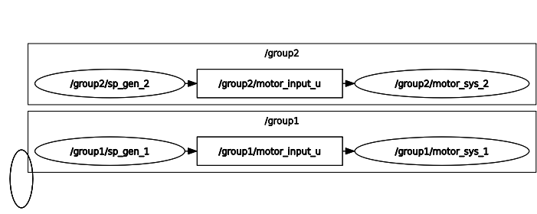
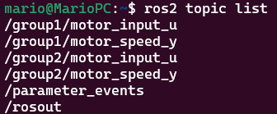
Activity 1 – ROS Namespaces
Build and run the newly created lunch file using colcon.
Open the rqt_graph to visualise the nodes
Tips
Add the rqt_graph to the launch file:
Results
$ cd ~/ros2_ws
$ colcon build
$ source install/setup.bash
$ ros2 launch motor_control motor_2_launch.py
$ ros2 run rqt_graph rqt_graph
rqt_graph_node = Node(name="rqt",
package='rqt_graph',
executable='rqt_graph',
output='screen'
)
l_d = LaunchDescription([motor_node_1, sp_node_1, motor_node_2, sp_node_2, rqt_graph_node])

Slide 18
Activity 1.1
ROS Namespaces 2

Slide 19
Activity 1.1 – ROS Namespaces 2
In the previous exercise, a namespace for each node was defined using the parameter
If the launch file contains many nodes, defining namespaces can become very difficult.
One solution is to call the entire launch file directly from another launch file (nested launch file) and assign a namespace so that every nested node will inherit that namespace.
Requirements
This activity requires the package motor_control.
For this example, three groups of nodes will be generated using namespaces.
A launch file will be to nest another launch file.
namespace= 'group1',

Slide 20
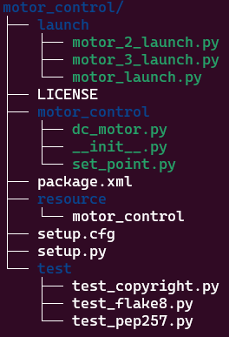
Activity 1.1 – ROS Namespaces 2
Create and open “motor_3_launch.py” file in the launch folder of the motor_control package.
Open the motor_3_launch.py on a text editor.
$ cd ~/ros2_ws/src/motor_control/launch
$ touch motor_3_launch.py
$ chmod +x motor_3_launch.py

Slide 21
Activity 1.1 – ROS Namespaces 2
#IMPORTS REQUIRED TO SET THE PACKAGE ADDRESS (DIRECTORIES)
import os
from ament_index_python.packages import get_package_share_directory
#iMPORTS REQUIRED FOR CALLING OTHER LAUNCH FILES (NESTING)
from launch import LaunchDescription
from launch.actions import IncludeLaunchDescription
from launch.launch_description_sources import PythonLaunchDescriptionSource
#IMPORTS REQUIRED TO PUSH A NAMESPACE (APPEND) A NAMESPACE TO A NESTED LAUNCH FILE
from launch.actions import GroupAction
from launch_ros.actions import PushRosNamespace
#INITIATE LAUNCH FILE
def generate_launch_description():
#USER VARIABLES
package = 'motor_control' #Package to be launched
launch_file = 'motor_launch.py' #Launch file to get a namespace
group1_ns = 'group1' #namespace to be used for group 1
group2_ns = 'group2' #namespace to be used for group 2
group3_ns = 'group3' #namespace to be used for group 3
#Get the address of the package
package_directory = get_package_share_directory(package)
#Get the address of the launch file
launch_file_path = os.path.join(package_directory, 'launch', launch_file)
#Set the launch file source for the group1 and group2
launch_source1 = PythonLaunchDescriptionSource(launch_file_path)
launch_source2 = PythonLaunchDescriptionSource(launch_file_path)
#Include the launch description for group1
talker_listener_launch_1 = IncludeLaunchDescription(launch_source1)
#Include the launch description for group2
talker_listener_launch_2 = IncludeLaunchDescription(launch_source2)
#Include the launch description for group3
#THIS IS ANOTHER WAY OF DOING THE PREVIOUS STEPS (MORE COMPACT) THE RESULTS ARE THE SAME
talker_listener_launch_3= IncludeLaunchDescription(
PythonLaunchDescriptionSource([os.path.join(
get_package_share_directory('motor_control'), 'launch'),
'/motor_launch.py'])
)
#SET NAMESPACE FOR ALL THE NODES INSIDE THE LAUNCH FILE
motor_control_group1 = GroupAction(
actions=[PushRosNamespace(group1_ns),
talker_listener_launch_1,
]
)
motor_control_group2 = GroupAction(
actions=[PushRosNamespace(group2_ns),
talker_listener_launch_2,
]
)
motor_control_group3 = GroupAction(
actions=[PushRosNamespace(group3_ns),
talker_listener_launch_3,
]
)
#LAUNCH THE DESCRIPTION
l_d = LaunchDescription([motor_control_group1, motor_control_group2, motor_control_group3]) return l_d

Slide 22
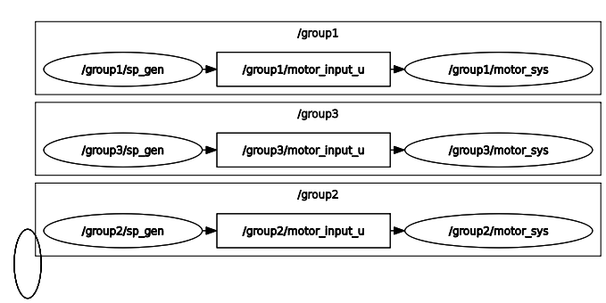
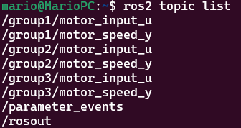
Activity 1.1 – ROS Namespaces 2
Build and run the newly created lunch file using colcon.
Open in another terminal the rqt_graph to visualise the nodes
Results
$ cd ~/ros2_ws
$ colcon build
$ source install/setup.bash
$ ros2 launch motor_control motor_3_launch.py
$ ros2 run rqt_graph rqt_graph

Slide 23
Robot Operating System – ROS
Parameters

Slide 24
ROS Parameters
Any software application, especially in robotics requires parameters.
Parameters are variables with some predefined values that are stored in a separate file or hardcoded in a program such that the user has easy access to change their value.
At the same time parameters can be shared amongst different programs to avoid rewriting them or recompiling the nodes (C++)
In robotics, parameters are used to store values requiring tunning, robot names, sampling times or flags.
ROS encourage the usage of parameters to avoid making dependencies or rewriting nodes.

Slide 25
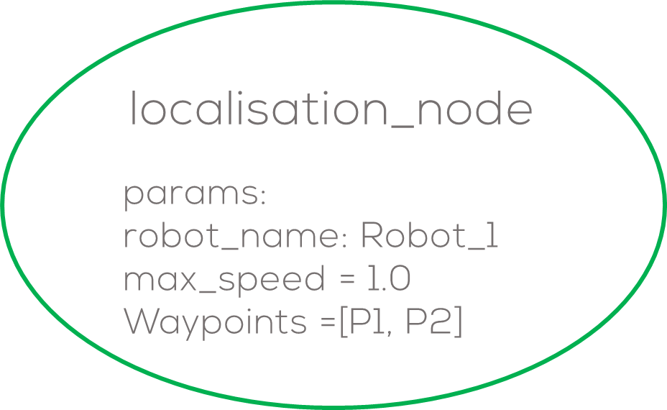
ROS Parameters
ROS parameters are stored in each node.
Nodes retrieve parameters at startup and runtime.
The lifetime of a parameter is the same as the node.
These parameters are used to configure nodes, e.g., robot constants, starting values, controller parameters, etc.
ROS can only use determined types of parameters such as:
Parameters are composed of a key, value and descriptor.
key value descriptor
<Name> <Value> <Description of the parameter (empty)>
bool, int64, float64, string, byte[], bool[], int64[], float64[] or string[]

Slide 26
Activity 2
Launch File Parameters

Slide 27
Activity 2 – Launch File Parameters
Requirements
motor_control ROS2 package.
Objective
The objective is to add parameters to the motor_control package.
Instructions
Open the package motor_control or the file “dc_motor.py” on a text editor.
Normally parameters are hardcoded as shown. Sometimes is difficult to access them when they are not organised (like in the example).
$ cd ~/ros2_ws/src/motor_control
$ code . (for vscode)
# DC Motor Parameters
self.sample_time = 0.02
self.param_K = 1.75
self.param_T = 0.5
self.initial_conditions = 0.0

Slide 28
Activity 2 – Launch File Parameters
Instructions
In this exercise those parameters will be set from the launch file, to allow the user change them without needing to open the code to change them.
Declaring a parameter
A parameter can be declared inside a script as follows.
To get the value of the parameter can be done as follows.
self.declare_parameter('sample_time', 0.02)
Name
Initial Value
# DC Motor Parameters
#Change them to ROS2 Parameters
self.sample_time = 0.02
self.param_K = 1.75
self.param_T = 0.5
self.initial_conditions = 0.0
self.sample_time = self.get_parameter('sample_time').value
Variable to store the value
Name of the parameter
Value

Slide 29
Activity 2 – Launch File Parameters
Instructions
Declare the following parameters in your code inside our constructor.
Instructions
A Set the variables to be used with the parameter values.
# Declare parameters
# System sample time in seconds
self.declare_parameter('sample_time', 0.02)
# System gain K
self.declare_parameter('sys_gain_K', 1.75)
# System time constant Tau
self.declare_parameter('sys_tau_T', 0.5)
# System initial conditions self.declare_parameter('initial_conditions', 0.0)
# DC Motor Parameters
self.sample_time = self.get_parameter('sample_time').value
self.param_K = self.get_parameter('sys_gain_K').value
self.param_T = self.get_parameter('sys_tau_T').value
self.initial_conditions = self.get_parameter('initial_conditions').value

Slide 30
dc_motor.py
# Imports
import rclpy
from rclpy.node import Node
from std_msgs.msg import Float32
#Class Definition
class DCMotor(Node):
def __init__(self):
super().__init__('dc_motor')
# Declare parameters
# System sample time in seconds
self.declare_parameter('sample_time', 0.02)
# System gain K
self.declare_parameter('sys_gain_K', 1.75)
# System time constant Tau
self.declare_parameter('sys_tau_T', 0.5)
# System initial conditions
self.declare_parameter('initial_conditions', 0.0)
# DC Motor Parameters
self.sample_time = self.get_parameter('sample_time').value
self.param_K = self.get_parameter('sys_gain_K').value
self.param_T = self.get_parameter('sys_tau_T').value
self.initial_conditions = self.get_parameter('initial_conditions').value
. . .
Libraries
The code should look like the one on the left.
Open the launch file motor_launch.py.
Add the parameters to the motor_node
Declare parameters
motor_node = Node(name="motor_sys",
package='motor_control',
executable='dc_motor',
emulate_tty=True,
output='screen',
parameters=[{
'sample_time': 0.02,
'sys_gain_K': 1.75,
'sys_tau_T': 0.5,
'initial_conditions': 0.0,
}
]
)
Code Continues

Slide 31
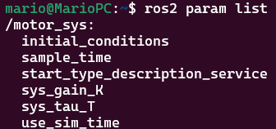
Activity 2 – Launch File Parameters
Instructions
Save and compile the file
Launch the node
Verify the new parameters on terminal
Results
To change a parameter, you must change it on the launch file and re-build the package using colcon build.
$ cd ~/ros2_ws
$ colcon build
$ source install/setup.bash
$ ros2 param get /motor_sys sys_gain_K
$ ros2 launch motor_control motor_launch.py
$ ros2 param list

Slide 32
ROS Parameters
Parameters Command Line
To list the parameters belonging to available nodes
To display the type and current value of a parameter
To change a parameter’s value at runtime (current session)
Dump all of a node’s current parameter values into a file to save them
You can load parameters from a file to a currently running node
To start the same node using your saved parameter values
$ ros2 param dump <node_name>
$ ros2 param list
$ ros2 param get <node_name> <parameter_name>
$ ros2 param load <node_name> <parameter_file>
$ ros2 param set <node_name> <parameter_name> <value>
$ ros2 run <package_name> <executable_name> --ros-args --params-file <file_name>

Slide 33
Robot Operating System – ROS
Parameter Callbacks

Slide 34
Parameter Callbacks
Setting a parameter as in the previous manner, allows us to set different values from the launch file.
The previous method does not allow to change parameters at runtime, nor verify if the parameters are the correct data type or value is within bounds.
Parameter callbacks
One simple solution would be to move the parameter get value inside the timer function…
This can be computationally expensive and unnecessary, especially if the parameter rarely changes.
If the loop is executing at a high frequency (e.g., every 10 ms), querying the parameter every iteration would be redundant and inefficient.
ROS2 implements parameter callbacks to ensure the parameters are updated only when a parameter is modified.

Slide 35
Parameter Callbacks
Start Node
Parameter callbacks
A parameter callback triggers only when a parameter is modified, ensuring that updates are applied in real-time without needing to check in every loop iteration.
This is particularly useful for applications where parameters might change at runtime (e.g., tuning control gains, adjusting robot behaviour dynamically).
The callback handles parameter updates.
The main loop handles the actual execution.
Initialise parameters
ROS Comms Interfaces and timers:
Shutdown
Parameter Callback
Check parameters
Update parameters
Exit signal
Waiting for events (callbacks)
New parameter received
ROS2 Spin
New input received
Timer
timeout
Subscriber Callback
Timer Callback (timer_cb)
35

Slide 36
Parameter Callbacks (Humble)
Parameter Callbacks
OnSet Callback (add_on_set_parameters_callback()):
Allows pre-validation of parameters before they are set.
The callback is passed a list of immutable Parameter objects.
Returns an rcl_interfaces/msg/SetParametersResult.
The main purpose of this callback is to give the user the ability to inspect the upcoming change to the parameter and explicitly reject the change.
import rclpy
from rclpy.node import Node
from rcl_interfaces.msg import SetParametersResult
class Control(Node):
def parameters_callback(self, params):
# validate parameters, update class attributes, etc.
return SetParametersResult(successful=True)
def __init__(self):
super().__init__('params_callback')
self.declare_parameter('P_gain', 0.5)
self.p_gain = self.get_parameter('P_gain').value
self.add_on_set_parameters_callback(self.parameters_callback)
...

Slide 37
Parameter Callbacks (Jazzy)
Parameter callbacks are divided into 3 categories.
PreSet Callback (add_pre_set_parameters_callback):
This callback is passed a list of the Parameter objects that are being changed.
Returns nothing.
When it is called, it can modify the Parameter list to change, add, or remove entries.
For example, change parameter data type, add parameters to the list of parameters or delete parameters
OnSet Callback (add_on_set_parameters_callback):
The callback is passed a list of immutable Parameter objects.
Returns an rcl_interfaces/msg/SetParametersResult.
Gives the user the ability to inspect the upcoming change to the parameter and explicitly reject the change.
For example, check if the parameter positive, within bounds etc.

Slide 38
Parameter Callbacks (Jazzy)
PostSet Callback (add_post_set_parameters_callback):
The callback is passed a list of immutable Parameter objects.
Returns nothing.
Gives the user the ability to react to changes from parameters that have successfully been accepted. (if SetParametersResults -> bool =True)
For example, change the variable inside the program, if the changes were accepted.
#Decalre parameter callbacks
self.add_on_set_parameters_callback(self.on_set_callback)
self.add_post_set_parameters_callback(self.post_set_callback)
# On-Set Callback Function
def on_set_callback(self, params):
for param in params:
#system gain parameter check
if param.name == "sys_gain_K":
#check if it is negative
if param.name == "sys_gain_K" and ( param.value < 0.0):
self.get_logger().warn("Invalid cannot be negative.")
return SetParametersResult(successful=False, reason="negative")
return SetParametersResult(successful=True, reason="parameters adjusted")
# Post-Set Callback Function
def post_set_callback(self, params):
for param in params:
#set the value of the parameter
if param.name == "sys_gain_K":
self.param_K = param.value # Update internal variable
self.get_logger().info(f"sys_gain_K updated to {self.param_K}")

Slide 39
Activity 2.1
Changing parameters at runtime

Slide 40
Activity 2.1: Parameter Callbacks
Setting the Parameter Callbacks
Open the dc_motor.py file with a text editor.
Add the message (interface) SetParameterResult at the top.
Set parameter the callback in the constructor.
Define a callback function inside the class DCMotor
# Imports
...
from rcl_interfaces.msg import SetParametersResult
class DCMotor(Node):
def __init__(self):
super().__init__('dc_motor')
# Declare parameters
# System sample time in seconds
self.declare_parameter('sample_time', 0.02)
...
#Parameter Callback
self.add_on_set_parameters_callback(self.parameters_callback)
...
def parameters_callback(self, params):
# validate parameters, update class attributes, etc.
return SetParametersResult(successful=True)

Slide 41
Activity 2.1: Parameter Callbacks
def parameters_callback(self, params):
for param in params:
#system gain parameter check
if param.name == "sys_gain_K":
#check if it is negative
if (param.value < 0.0):
self.get_logger().warn("Invalid sys_gain_K! It cannot be negative.")
return SetParametersResult(successful=False, reason="sys_gain_K cannot be negative")
else:
self.param_K = param.value # Update internal variable
self.get_logger().info(f"sys_gain_K updated to {self.param_K}")
#system gain parameter check
if param.name == "sys_tau_T":
#check if it is negative
if (param.value < 0.0):
self.get_logger().warn("Invalid sys_tau_T! It cannot be negative.")
return SetParametersResult(successful=False, reason="sys_tau_T cannot be negative")
else:
self.param_T = param.value # Update internal variable
self.get_logger().info(f"sys_tau_T updated to {self.param_T}")
return SetParametersResult(successful=True)
Callbacks Function
Fill the callback function as shown.
The callback function will receive the list of the parameters to be modified (params).
For each parameter inside the list:
Verify the parameters are within bounds
Set the variables that drive the system.

Slide 42
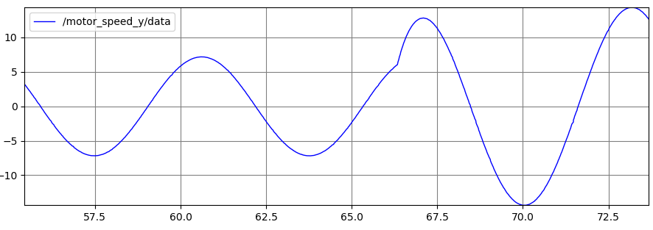
Activity 2 – Launch File Parameters
Instructions
Save and compile the file
Launch the node
Verify the new parameters on terminal
Results
Open the rqt_plot
Change a parameter gain K
$ ros2 run rqt_plot rqt_plot
$ cd ~/ros2_ws
$ colcon build
$ source install/setup.bash
$ ros2 param set /motor_sys sys_gain_K 8.0
$ ros2 launch motor_control motor_launch.py
$ ros2 param list

Slide 43
Robot Operating System – ROS
Parameter Files

Slide 44
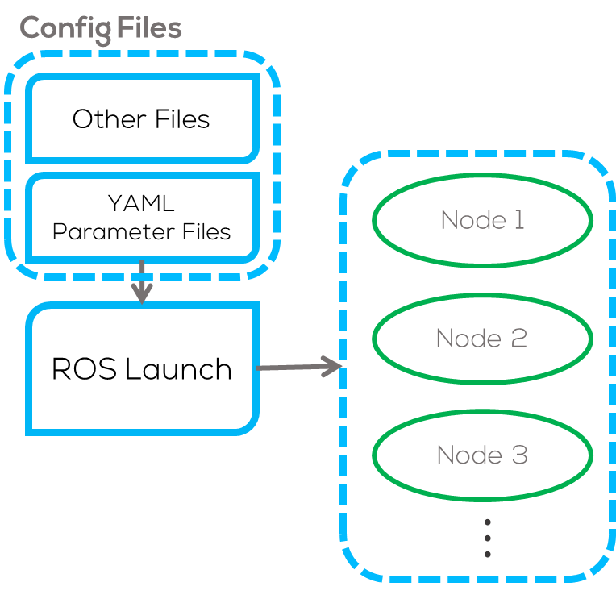
Parameter files
Parameter Files
The previous way of defining parameters is very useful, but for the case when having to define many different parameters this can become very inefficient.
ROS offers the capability to define parameters using a parameter file.
This parameter file is called YAML file because of the language is written (YAML: yet another markup language)
Notes:
Parameters — rclpy 0.6.1 documentation (ros2.org)
ROS2 YAML For Parameters - The Robotics Back-End (roboticsbackend.com)

Slide 45
Parameter files
YAML Files
These files are commonly used in other languages to set up parameters or variables.
The way to define the hierarchy of a parameter, like in python depends on spacing!!!.
The parameters set up in the config files (YAML Files) can be declared, private to a node or using “wildcards” will assign all the parameters in every node, despite differences in node names and namespaces.
/**:
ros__parameters:
sample_time: 0.5
node_1:
ros__parameters:
some_text: "abc"
node_2:
ros__parameters:
int_number: 27
float_param: 45.2
node_3:
ros__parameters:
int_number: 45
Notes:
Parameters — rclpy 0.6.1 documentation (ros2.org)
ROS2 YAML For Parameters - The Robotics Back-End (roboticsbackend.com)

Slide 46
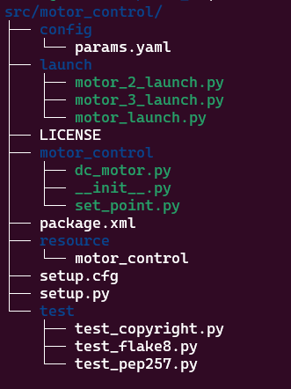
Parameter files
YAML file
The same as you would put your launch files into a “launch” folder, you can put all your YAML config files into a “config” folder, directly at the root of your package.
Inside the config folder create a file named “params.yaml” (the file can have any name just make sure follow a convention properly).
The YAML file will be called by the launch file and set all the parameters according to the node and namespace (if applicable).

Slide 47
Activity 2.2
Parameter Files

Slide 48
Activity 2.2 – Parameter file
Requirements
For this activity the motor_control package will be used.
The previous namespace activity must be completed since motor_2_launch.py file will be used.
Instructions
Create a “config” folder in “motor_control” package.
Create a “params.yaml” file inside the “config” folder.
$ cd ~/ros2_ws
$ mkdir src/motor_control/config
$ touch src/motor_control/config/params.yaml

Slide 49
Activity 2.2 – Parameter file
Instructions
The parameters will be set for the “motor_2_launch.py” file.
The “motor_2_launch.py” invokes two groups of nodes containing a motor node and a set point node respectively with a namespace, respectively.

Slide 50
Activity 2.2 – Parameter file
Instructions
Open the “parameter.yaml” file using a text editor.
According to the namespace and the robot's name assign the parameters to be set.
/**:
ros__parameters:
#WILDCARD: Parameters to be assigned
#in every node, despite differences
#in node names and namespaces
/group1/motor_sys_1:
ros__parameters: #Careful is double underscore __
sys_gain_K: 2.0 #Parameter to be changed
sys_tau_T: 0.9
/group2/motor_sys_1:
ros__parameters:
sys_gain_K: 1.75
sys_tau_T: 0.5
motor_node_1 = Node(name="motor_sys_1",
package='motor_control',
executable='dc_motor',
emulate_tty=True,
output='screen',
namespace="group1"
)
motor_2_launch.py

Slide 51
Activity 2.2 – Parameter file
Instructions
Copy the following parameters inside the “params.yaml” file (careful with the spaces).
Open the file setup.py of the motor_control package, and add the following to the data_files part:
As follows (don’t forget the comma before and after):
Open the launch file “motor_2_launch.py” on a text editor and modify it as shown on the next slide.
(os.path.join('share', package_name, 'config'), glob(os.path.join('config', '*.[yma]*'))),
/group1/motor_sys_1:
ros__parameters:
sys_gain_K: 4.0
sys_tau_T: 0.9
/group2/motor_sys_1:
ros__parameters:
sys_gain_K: 1.75
sys_tau_T: 0.5
data_files=[
('share/ament_index/resource_index/packages',
['resource/' + package_name]),
('share/' + package_name, ['package.xml']),
(os.path.join('share', package_name, 'launch'), glob(os.path.join('launch', '*launch.[pxy][yma]*'))),
(os.path.join('share', package_name, 'config'), glob(os.path.join('config', '*.[yma]*'))),
],

Slide 52
Activity 2.2 – Parameter file
#Packages to get the address of the YAML file
import os
from ament_index_python.packages import get_package_share_directory
#Launch Pacckages
from launch import LaunchDescription
from launch_ros.actions import Node
def generate_launch_description():
#Get the address of the YAML File
config = os.path.join(
get_package_share_directory('motor_control'),
'config',
'params.yaml'
)
motor_node_1 = Node(name="motor_sys_1",
package='motor_control',
executable='dc_motor',
emulate_tty=True,
output='screen',
namespace="group1",
parameters=[config]
)
sp_node_1 = Node(name="sp_gen_1",
package='motor_control',
executable='set_point',
emulate_tty=True,
output='screen',
namespace="group1"
)
motor_node_2 = Node(name="motor_sys_2",
package='motor_control',
executable='dc_motor',
emulate_tty=True,
output='screen',
namespace="group2",
parameters=[config]
)
sp_node_2 = Node(name="sp_gen_2",
package='motor_control',
executable='set_point',
emulate_tty=True,
output='screen',
namespace="group2"
)
l_d = LaunchDescription([motor_node_1, sp_node_1, motor_node_2, sp_node_2]) return l_d

Slide 53
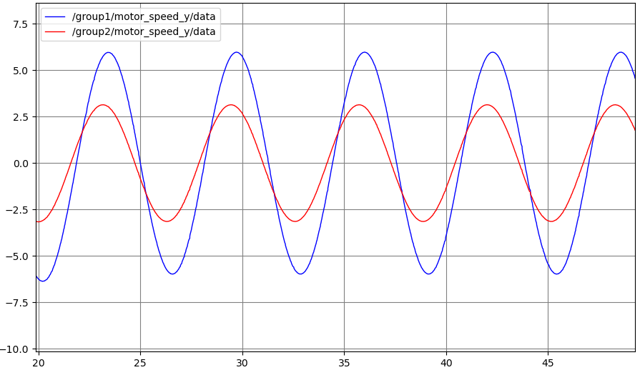
Activity 2 – Launch File Parameters
Instructions
Save and compile the file
Launch the node
Verify the new parameters on terminal
Results
Open the rqt_plot
Check the parameter gain K
$ ros2 run rqt_plot rqt_plot
$ cd ~/ros2_ws
$ colcon build
$ source install/setup.bash
$ ros2 param get /group1/motor_sys_1 sys_gain_K
Double value is: 4.0
$ ros2 launch motor_control motor_2_launch.py
$ ros2 param list

Slide 54
Robot Operating System – ROS
Services

Slide 55
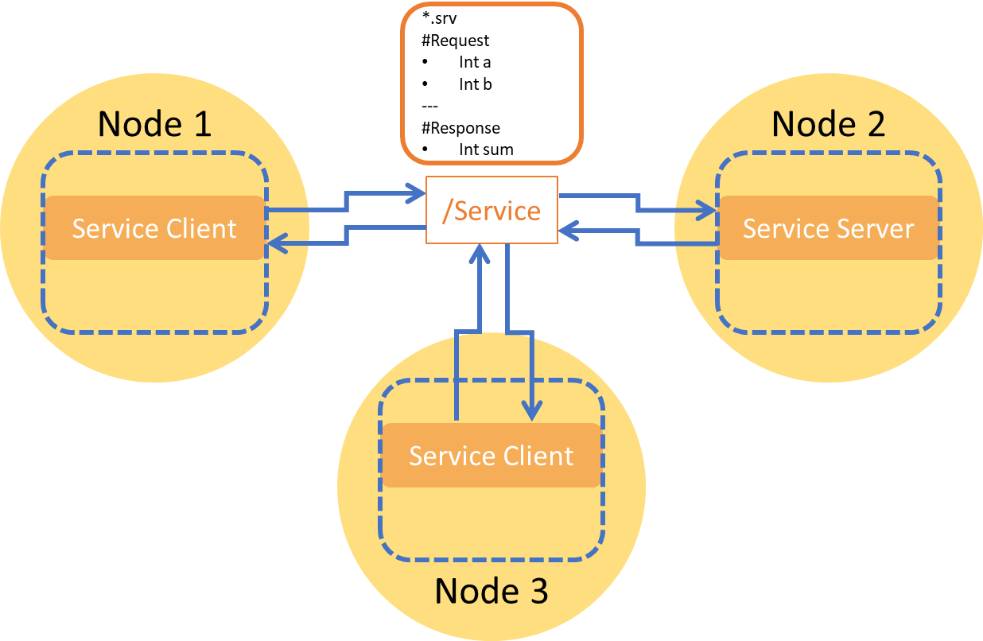
Services
Service Interface
Services are a vital method of communication for nodes within the Robot Operating System (ROS).
A service operates on a request/response pattern, where a client sends a request to the service-providing node. The service processes this request and delivers a response.
In contrast to topics that deliver continuous updates, services are highly efficient, providing data exclusively upon client request. This makes services an essential choice for on-demand data retrieval.
Notes:
You generally don’t want to use a service for continuous calls; topics or even actions would be better suited.

Slide 56
Topics vs Services
Topics | Services
Continuous data exchange (e.g., sensor readings, odometry) | On-demand queries (e.g., turning a robot on/off, getting robot state)
One-way (publish) | Two-way (request & response)
Asynchronous (Publisher/Subscriber) | Synchronous (Not recommended), Asynchronous (Recommended)
Multiple nodes can receive the same topic data | Communication only between the client and the server.
Topics continuously publish messages, even when they are not needed. | Services only communicate when needed, saving bandwidth.
Best-effort or reliable (QoS settings) | Always expects a response
Can be used for every process. | They should never be used for longer running processes, in particular processes that might be required to preempt if exceptional situations occur.
Topics have no built-in response verification | allow error handling since they can return a response indicating success, failure, or an error message.

Slide 57
Topics vs Services
Use Case | Best Option
Continuous sensor data (e.g., LiDAR, camera) | Topic
Sending control commands (e.g., velocity commands) | Topic
Requesting the robot’s current position | Service
Sending a start/stop command for a task | Service
Broadcasting environmental conditions (e.g., battery level, wheel pressure) | Service

Slide 58
Service interfaces
ROS2 services use a request-response communication model.
A service consists of two parts:
Request: The message (interface) sent by the client.
Response: The message returned by the server.
Service interfaces as messages consists of a data structure, where the user represents the request and the response separated by “---”
# This is aservice to set a boolean value.
# This can be used for starting a process
bool enable # Request e.g. for hardware enabling / disabling
--- #Response
bool success # Response indicate successful run service
string message # informational, e.g. for error messages
Some Service Interfaces are predefined by ROS (here) but normally, they are customised for each need.
To develop custom interfaces, a package must be made using CMake.

Slide 59
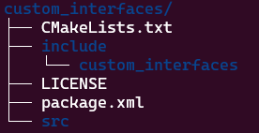
CMake Packages
As with Python, ROS can develop packages using CMake (C++ based) when building.
CMake (ament_cmake): Used when compiling C++-based ROS2 packages.
Python (ament_python): Used for Python-based ROS2 packages.
When building a C++ node using CMake in Colcon, the compiler requires some configurations, dependencies and build rules.
The CMakeLists and package.xml are the files containing the configuration, dependencies paths and build rules.
CMake generates configuration used by the compiler files using CMakeLists.txt file.
More information about CMakeLists when using C++ can be found here and here.
Examples of CMakeLists files can be found here.

Slide 60
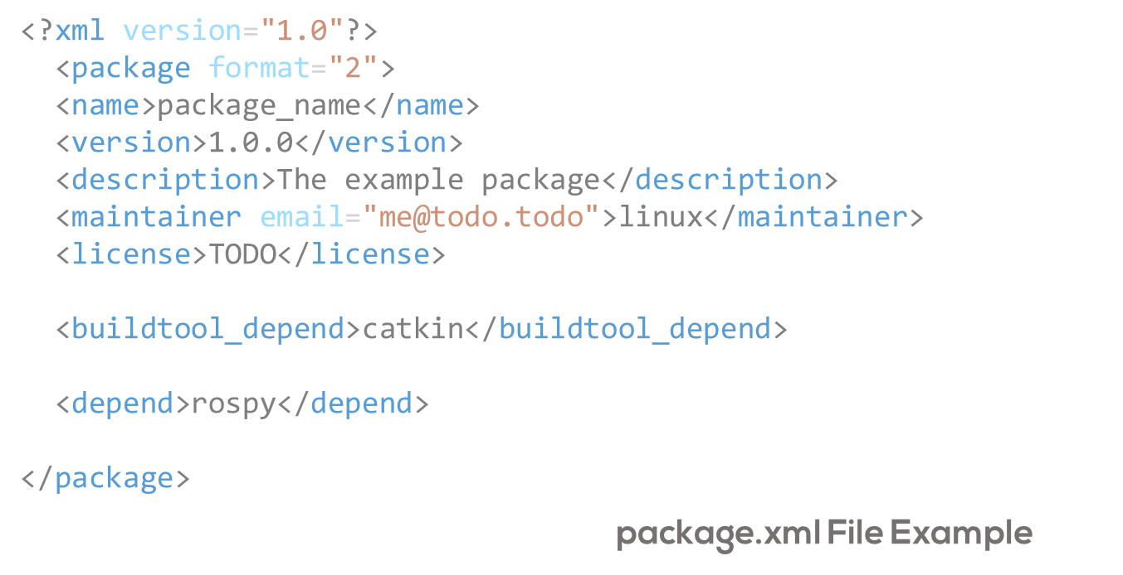
Package.xml File
Package manifest file.
Contains the metadata of the package.
XML File that must be included with any catkin-compliant package.
Defines the properties about the package such as the package name, version numbers, authors, maintainers, and dependencies on other catkin packages.
More information about Package.xml files can be found here, here and here.

Slide 61
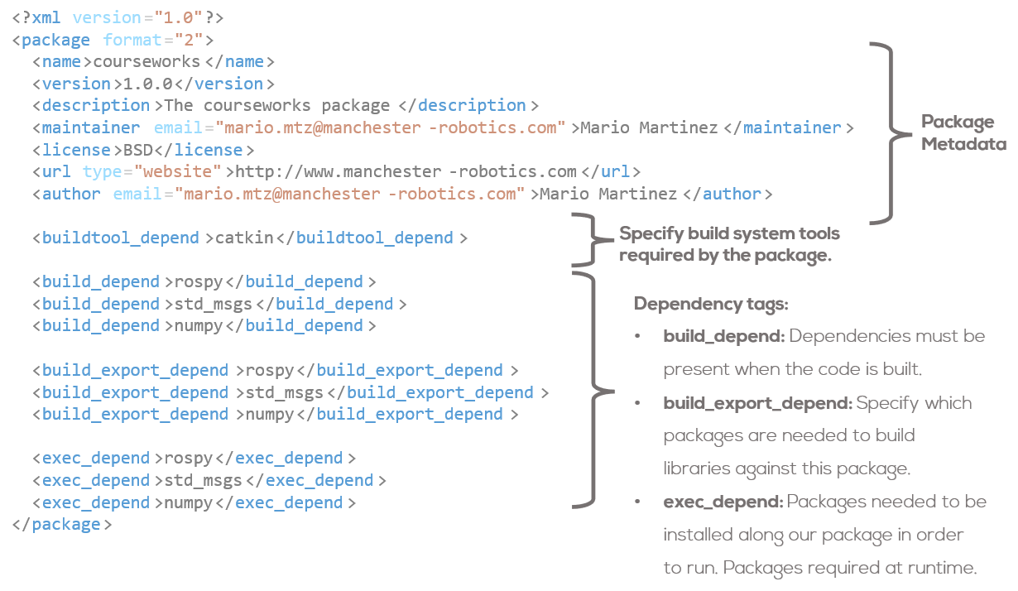
Package.xml File Dependencies
exec_depend: Packages required at runtime. The most common dependency for a python-only package. If your package or launchfile imports/runs code from another package.
build_depend: Package required at build time. Python packages usually do not require this. Some exceptions is when you depend upon messages, services or other packages.
build_export_depend: Specify which packages are needed to build libraries against this package. This is the case when you transitively include their headers in public headers in this package
Notes:
Your CMakeLists.txt need not specify Python-only dependencies. They are resolved automatically via sys.path.
The dependencies declared in the manifest are not used in the build process. if you omit them here, you likely won’t see any error messages until you distribute your package to others who try to build it without having the required packages installed.

Slide 62
Activity 3
Custom Interface Services

Slide 63
Activity 3 – Custom Interface Services (Custom Interface)
Requirements
For this activity, the previously modified motor_control package will be used.
Objective
The objective in tis activity is to set a simple service between the set_point generator and the dc_motor node to start and stop the dc_motor node.
For this activity, a server will be set in the dc_motor node and a client on the set_point node.
A custom interface will be used for this activity.
Custom Interface Package
Create a CMake “custom_interfaces” package
Make a folder called srv inside the “custom_interfaces” package and a Service interface called SetProcessBool.srv.
$ cd ~/ros2_ws/src
$ ros2 pkg create --build-type ament_cmake custom_interfaces --dependencies std_msgs geometry_msgs --license Apache-2.0
$ mkdir custom_interfaces/srv
$ touch custom_interfaces/srv/SetProcessBool.srv

Slide 64
Activity 3 – Custom Interface Services (Custom Interface)
Custom Interface Package
Open the SetProcessBool.srv file and write the following.
Open CMakeLists.txt and add the following lines and save the file.
# find dependencies
find_package(ament_cmake REQUIRED)
find_package(std_msgs REQUIRED)
find_package(geometry_msgs REQUIRED)
find_package(rosidl_default_generators REQUIRED)
rosidl_generate_interfaces(${PROJECT_NAME}
"srv/SetProcessBool.srv"
DEPENDENCIES std_msgs
)
# Custom Interface
# This is a service to set a boolean value.
# This can be used for starting a process
bool enable #for hardware enabling / disabling
---
bool success # indicate successful run service
string message # informational

Slide 65
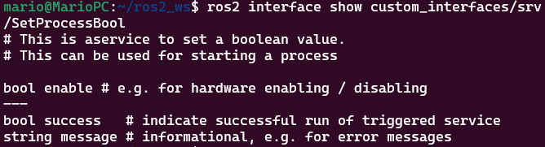
Activity 3 – Custom Interface Services (Custom Interface)
Custom Interface Package
Open package.xml, add the following lines and save the file.
Build the workspace and source it
Results
Validate that the sphere message has been properly created
$ ros2 interface show custom_interfaces/srv/SetProcessBool
<buildtool_depend>rosidl_default_generators</buildtool_depend>
<exec_depend>rosidl_default_runtime</exec_depend>
<member_of_group>rosidl_interface_packages</member_of_group>
$ cd ~/ros2_ws
$ colcon build
$ source install/setup.bash

Slide 66
Activity 3 – Custom Interface Services (Server)
Creating a server
Open the dc_motor.py from motor_control package.
Import the newly created custom interface at the top.
Define a Boolean variable “simulation_running” in the constructor.
Define a server callback function inside the constructor.
def __init__(self):
super().__init__('dc_motor’)
...
self.simulation_running = False
#Set Server callback
self.srv = self.create_service(SetProcessBool, 'EnableProcess’, self.simulation_service_callback)
# Imports
import rclpy
from rclpy.node import Node
from std_msgs.msg import Float32
from rcl_interfaces.msg import SetParametersResult
from custom_interfaces.srv import SetProcessBool

Slide 67
Activity 3 – Custom Interface Services (Server)
Define the Server Callback
Create the function “simulation_service_callback” within the class.
This function will update the variable “simulation_running”.
Inside the timer callback use the “simulation_running” variable to stop the DC_Motor Simulation.
#Timer Callback
def timer_cb(self):
if not self.simulation_running:
return # Stop processing if simulation is not running
#DC Motor Simulation
#DC Motor Equation 𝑦[𝑘+1] = 𝑦[𝑘] + ((−1/𝜏) 𝑦[𝑘] + (𝐾/𝜏) 𝑢[𝑘]) 𝑇_𝑠
...
# Service Callback to Start/Stop Simulation
def simulation_service_callback(self, request, response):
if request.enable:
self.simulation_running = True
self.get_logger().info("🚀 Simulation Started")
response.success = True
response.message = "Simulation Started Successfully"
else:
self.simulation_running = False
self.get_logger().info("🛑 Simulation Stopped")
response.success = True
response.message = "Simulation Stoped Successfully"
return response

Slide 68
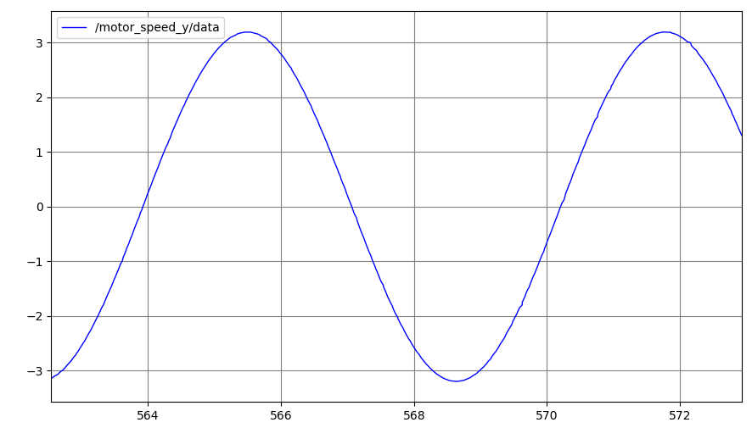
Activity 3 – Custom Interface Services (Server)
Instructions
Save and compile the file
Launch the node
Open the rqt_plot and verify the output signal
Server Results
Open a new terminal (when calling a service always source the terminals)
$ cd ~/ros2_ws
$ colcon build
$ source install/setup.bash
$ source install/setup.bash
$ ros2 service call /EnableProcess custom_interfaces/srv/SetProcessBool '{enable: true}’
$ ros2 service call /EnableProcess custom_interfaces/srv/SetProcessBool '{enable: false}'
$ ros2 launch motor_control motor_launch.py
$ ros2 run rqt_plot rqt_plot

Slide 69
ROS Services - Command Line
Services Command Line
To verify type of a service
To see the types of all the active services
To find all the services of a specific type
To know the structure of the input arguments of a service
To call a service
$ ros2 interface show <type_name>
$ ros2 service type <service_name>
$ ros2 service call <service_name> <service_type> <arguments>
$ ros2 service list -t
$ ros2 service find <type_name>

Slide 70
Activity 3 – Custom Interface Services (Client)
Define a Client
Create a client “cli” and wit for the service to be available.
Define a send request function (to be created) in the constructor.
Define a variable “system_running in the constructor as well.”
Define a Client
Open the set_point.py inside motor_control package.
Import the newly created custom interface at the top.
# Imports
import rclpy
from rclpy.node import Node
import numpy as np
from std_msgs.msg import Float32
from custom_interfaces.srv import SetProcessBool
def __init__(self):
super().__init__('dc_motor’)
...
self.system_running = False
#Create a service client for /EnableProcess
self.cli = self.create_client(SetProcessBool, 'EnableProcess')
while not self.cli.wait_for_service(timeout_sec=1.0):
self.get_logger().info('service not available, waiting again...’)
...
self.send_request(True)

Slide 71
Activity 3 – Custom Interface Services (Client)
Define a Client
This function sends a request to the server, as True in the enable variable from the custom interface.
future is an asynchronous task that will eventually contain the result of the service call.
It allows non-blocking execution, meaning the program can continue running while waiting for the service response.
When the service call is completed, the result will
Adds a callback to the response to make the server communication asynchronous.
def send_request(self, enable: bool):
request = SetProcessBool.Request()
request.enable = enable
#Send a request to start or stop the simulation future = self.cli.call_async(request)
future.add_done_callback(self.response_callback)
custom interface
bool enable #Request
---
bool success # Response
string message

Slide 72
Activity 3 – Custom Interface Services (Client)
Define a Client Callback function
This function process the callback from the server, once the server has finished its task.
The callback sets the variable “system_running” to True and logs the message received by the server in the Response “string message” of the interface.
def response_callback(self, future):
"""Process the service response."""
try:
response = future.result()
if response.success:
self.system_running = True
self.get_logger().info(f'Success: {response.message}')
else:
self.simulation_running = False
self.get_logger().warn(f'Failure: {response.message}')
except Exception as e:
self.simulation_running = False
self.get_logger().error(f'Service call failed: {e}')

Slide 73
Activity 3 – Custom Interface Services (Client)
Using the “system_running” variable, it is possible now to activate the “set_point” node the same way as the “dc_motor” node.
The node will activate after the process node is active, giving us more control on the order/sequence on how the nodes activate.
set_point and dc_motor nodes are launched (without order)
set_point node, does not start publishing (idle) (system_running = False).
set_point node sends a request to the server (dc_motor node).
dc_motor node receives request and starts publishing.
dc_motor node sends response to the set_point node.
set_point node receives response, process it and starts publishing.
# Timer Callback: Generate and Publish Sine Wave Signal
def timer_cb(self):
if not self.system_running:
return # Stop processing if simulation is not running
...

Slide 74
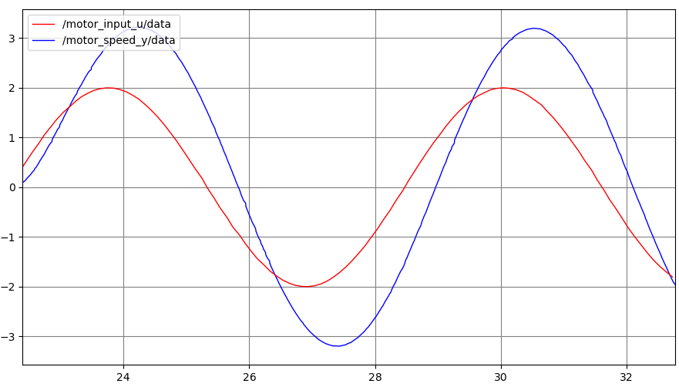
Activity 3 – Custom Interface Services (Client)
Instructions
Save and compile the file
Launch the node
Open the rqt_plot and verify the output signal
Results
$ cd ~/ros2_ws
$ colcon build
$ source install/setup.bash
$ ros2 launch motor_control motor_launch.py
$ ros2 run rqt_plot rqt_plot

Slide 75
Activity Extra
Making a DC Motor Simulator

Slide 76
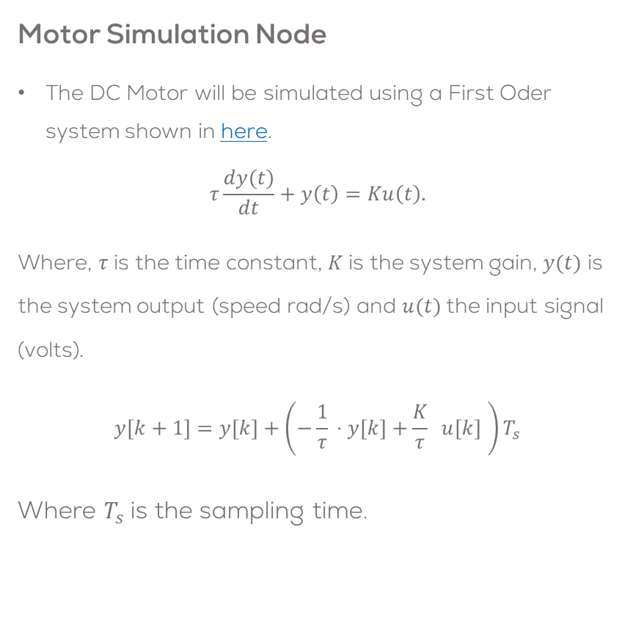
Making a DC Motor Simulator
Requirements
You can download the motor_control template package from Github. Otherwise, follow the instructions.
Objective
The objective of this activity is to learn about namespaces, parameters and client-server communication.
The package will be composed of three nodes:
dc_motor node: Simulate a First Order System, representing a DC Motor.
set_point node: Providing an input for the system.
Controller Node: Make a controller for the DC Motor (save this for the challenge).
Motor Simulation Node
The DC Motor will be simulated using a First Oder system shown in here.
$$τ\frac{dy(t)}{dt}+y\left(t\right)=Ku\left(t\right).$$
Where, $τ$ is the time constant, $K$ is the system gain, $y(t)$ is the system output (speed rad/s) and $u(t)$the input signal (volts).
$$y\left[k+1\right]=y\left[k\right]+\left(−\frac{1}{τ}​⋅y\left[k\right]+\frac{K}{τ}​ ​ u[k] \right)T_{s}$$
Where $T_{s}$is the sampling time.

Slide 77
Making a DC Motor Simulator
Instructions
You can download the motor_control template package from Github. Otherwise, follow the instructions.
Create a motor_control package, a dc_motor node and a set_point .
Instructions
Make a motor_launch.py file
$ mkdir /motor_control/launch
$ touch /motor_control/launch/motor_launch.py
$ chmod +x motor_control/launch/*
$ cd ~/ros2_ws/src/
$ ros2 pkg create --build-type ament_python motor_control --node-name dc_motor --license Apache-2.0 --dependencies rclpy std_msgs ros2launch
$ touch motor_control/motor_control/set_point.py
$ chmod +x motor_control/motor_control/*

Slide 78
dc_motor.py
# Imports
import rclpy
from rclpy.node import Node
from std_msgs.msg import Float32
#Class Definition
class DCMotor(Node):
def __init__(self):
super().__init__('dc_motor')
# DC Motor Parameters
self.sample_time = 0.02
self.param_K = 1.75
self.param_T = 0.5
self.initial_conditions = 0.0
#Set the messages
self.motor_output_msg = Float32()
#Set variables to be used
self.input_u = 0.0
self.output_y = self.initial_conditions
#Declare publishers, subscribers and timers
self.motor_input_sub = self.create_subscription(Float32, 'motor_input_u', self.input_callback,10)
self.motor_speed_pub = self.create_publisher(Float32, 'motor_speed_y', 10)
self.timer = self.create_timer(self.sample_time, self.timer_cb)
#Node Started
self.get_logger().info('Dynamical System Node Started \U0001F680')
#Timer Callback
def timer_cb(self):
#DC Motor Simulation
#DC Motor Equation 𝑦[𝑘+1] = 𝑦[𝑘] + ((−1/𝜏) 𝑦[𝑘] + (𝐾/𝜏) 𝑢[𝑘]) 𝑇_𝑠
self.output_y += (-1.0/self.param_T * self.output_y + self.param_K/self.param_T * self.input_u) * self.sample_time
#Publish the result
self.motor_output_msg.data = self.output_y
self.motor_speed_pub.publish(self.motor_output_msg)
#Subscriber Callback
def input_callback(self, input_sgn):
self.input_u = input_sgn.data
#Main
def main(args=None):
rclpy.init(args=args)
node = DCMotor()
try:
rclpy.spin(node)
except KeyboardInterrupt:
pass
finally:
node.destroy_node()
rclpy.try_shutdown()
#Execute Node
if __name__ == '__main__':
main()

Slide 79
set_point.py
# Imports
import rclpy
from rclpy.node import Node
import numpy as np
from std_msgs.msg import Float32
#Class Definition
class SetPointPublisher(Node):
def __init__(self):
super().__init__('set_point_node')
# Retrieve sine wave parameters
self.amplitude = 2.0
self.omega = 1.0
#Create a publisher and timer for the signal
self.signal_publisher = self.create_publisher(Float32, 'motor_input_u', 10)
timer_period = 0.1 #seconds
self.timer = self.create_timer(timer_period, self.timer_cb)
#Create a messages and variables to be used
self.signal_msg = Float32()
self.start_time = self.get_clock().now()
self.get_logger().info("SetPoint Node Started \U0001F680")
# Timer Callback: Generate and Publish Sine Wave Signal
def timer_cb(self):
#Calculate elapsed time
elapsed_time = (self.get_clock().now() - self.start_time).nanoseconds/1e9
# Generate sine wave signal
self.signal_msg.data = self.amplitude * np.sin(self.omega * elapsed_time)
# Publish the signal
self.signal_publisher.publish(self.signal_msg)
#Main
def main(args=None):
rclpy.init(args=args)
set_point = SetPointPublisher()
try:
rclpy.spin(set_point)
except KeyboardInterrupt:
pass
finally:
set_point.destroy_node()
rclpy.try_shutdown()
#Execute Node
if __name__ == '__main__':
main()

Slide 80
setup.py
Instructions
Open the setup.py and add the following lines to localise the launch file packages and the entry points of the newly created nodes.
from setuptools import find_packages, setup
import os
from glob import glob
...
data_files=[
('share/ament_index/resource_index/packages',
['resource/' + package_name]),
('share/' + package_name, ['package.xml']),
(os.path.join('share', package_name, 'launch'), glob(os.path.join('launch', '*launch.[pxy][yma]*'))),
],
...
entry_points={
'console_scripts': [
'dc_motor = motor_control.dc_motor:main',
'set_point = motor_control.set_point:main'
],
...

Slide 81
motor_launch.py
from launch import LaunchDescription
from launch_ros.actions import Node
def generate_launch_description():
motor_node = Node(name="motor_sys",
package='motor_control',
executable='dc_motor',
emulate_tty=True,
output='screen',
)
sp_node = Node(name="sp_gen",
package='motor_control',
executable='set_point',
emulate_tty=True,
output='screen',
)
l_d = LaunchDescription([motor_node, sp_node])
return l_d
Build the nodes
Launch the package and rqt_graph
$ colcon build
$ source install/setup.bash
$ ros2 launch motor_control motor_launch.py
$ ros2 run rqt_graph rqt_graph

Slide 82
Robot Operating System – ROS
Custom Messages

Slide 83
ROS Custom messages
ROS has some predefined messages like the std_messages, geometric_messages, etc.
Sometimes, the message structures are required to be altered for a custom application.
ROS allows the user to customise the messages and create new messages.
Custom messages are a way to personalise your own messages for a specific purpose or application.
Custom messages are created by the user, and must be linked to the package where they will be used.
More information here, here and here .

Slide 84
ROS Custom messages
For this example, a new message will be generated to contain two different values of data.
Two types of message will be used for the message.
For this example, only one topic will be necessary, and the message will include the information that describes the position and radius of a sphere

Slide 85
Activity – Message interfaces
Navigate to your workspace and go to the src folder
Create a new package
Open the Sphere.msg file and write the following
$ cd ~/ros2_ws/src/
$ ros2 pkg create --build-type ament_cmake --license Apache-2.0 srv_int
$ cd srv_int
$ mkdir msg
$ touch msg/Sphere.msg
geometry_msgs/Point center
float64 radius

Slide 86
Activity – Message interfaces
Open CMakeLists.txt and add the following lines
Do the same inside package.xml
find_package(geometry_msgs REQUIRED)
find_package(rosidl_default_generators REQUIRED)
rosidl_generate_interfaces(${PROJECT_NAME}
"msg/Sphere.msg"
DEPENDENCIES geometry_msgs
)
<depend>geometry_msgs</depend>
<buildtool_depend>rosidl_default_generators</buildtool_depend>
<exec_depend>rosidl_default_runtime</exec_depend>
<member_of_group>rosidl_interface_packages</member_of_group>

Slide 87
Activity – Message interfaces
Build the workspace and source it
Validate that the sphere message has been properly created
$ colcon build
$ source install/setup.bash
$ ros2 interface show srv_int/msg/Sphere

Slide 88
Activity – Message interfaces
Navigate to your workspace and go to the src folder
Create a new package
Open the sphere_node.py file and write the following
$ cd ~/ros2_ws/src/
$ ros2 pkg create --build-type ament_python --license Apache-2.0 sphere_msgs --node-name sphere_node --dependencies geometry_msgs srv_int

Slide 89
import rclpy
from rclpy.node import Node
from srv_int.msg import Sphere
import numpy as np
class CustomMsgPublisher(Node):
def __init__(self):
super().__init__('custom_msg_node')
self.pub = self.create_publisher(Sphere, 'sphere_position', 10)
self.timer_period = 0.1
self.timer = self.create_timer(self.timer_period, self.timer_callback)
self.x = 0
self.y = 0
self.z = 0
self.r = 1.5
self.time = 0
self.get_logger().info('Custom Sphere msg initialized')
def timer_callback(self):
msg = Sphere()
self.r = 1.5 + 0.5*np.sin(self.time)
self.time += self.timer_period
msg.radius = self.r
self.pub.publish(msg)
def main(args=None):
rclpy.init(args=args)
c_m_p = CustomMsgPublisher()
rclpy.spin(c_m_p)
c_m_p.destroy_node()
rclpy.shutdown()
if __name__ == '__main__':
main()

Slide 90
Activity – Message interfaces
You have already solved the dependencies since you built the package
Build your workspace and source it
Check the behavior by using echo
Plot the radius using rqt_plot
$ colcon build
$ source install/setup.bash
$ ros2 run sphere_msgs sphere_node
$ ros2 topic echo /sphere_position
$ ros2 run rqt_plot rqt_plot

Slide 91
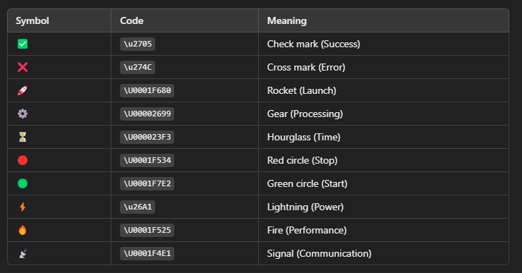

Slide 92


Q&A
Questions?

Slide 93
Thank You
Robotics For Everyone

Slide 94
T&C
Terms and conditions

Slide 95
Terms and conditions
THE PIECES, IMAGES, VIDEOS, DOCUMENTATION, ETC. SHOWN HERE ARE FOR INFORMATIVE PURPOSES ONLY. THE DESIGN IS PROPRIETARY AND CONFIDENTIAL TO MANCHESTER ROBOTICS LTD. (MCR2). THE INFORMATION, CODE, SIMULATORS, DRAWINGS, VIDEOS PRESENTATIONS ETC. CONTAINED IN THIS PRESENTATION IS THE SOLE PROPERTY OF MANCHESTER ROBOTICS LTD. ANY REPRODUCTION, RESELL, REDISTRIBUTION OR USAGE IN PART OR AS A WHOLE WITHOUT THE WRITTEN PERMISSION OF MANCHESTER ROBOTICS LTD. IS STRICTLY PROHIBITED.
THIS PRESENTATION MAY CONTAIN LINKS TO OTHER WEBSITES OR CONTENT BELONGING TO OR ORIGINATING FROM THIRD PARTIES OR LINKS TO WEBSITES AND FEATURES IN BANNERS OR OTHER ADVERTISING. SUCH EXTERNAL LINKS ARE NOT INVESTIGATED, MONITORED, OR CHECKED FOR ACCURACY, ADEQUACY, VALIDITY, RELIABILITY, AVAILABILITY OR COMPLETENESS BY US.
WE DO NOT WARRANT, ENDORSE, GUARANTEE, OR ASSUME RESPONSIBILITY FOR THE ACCURACY OR RELIABILITY OF ANY INFORMATION OFFERED BY THIRD-PARTY WEBSITES LINKED THROUGH THE SITE OR ANY WEBSITE OR FEATURE LINKED IN ANY BANNER OR OTHER ADVERTISING.

